Slide 1
TITLE PAGE
2023
UNIT
KICKOFF

Slide 2
WHY SELL POPCORN?
Fund [Unit #] Adventures
[Insert your Unit Leader Planner Adventures & Expenses here]
Examples
Campouts
Blue & Gold Celebration
Pinewood Derby
High Adventures
Equipment needs
Advancement
Annual dues
Scouts Learn
The value of hard work
How to earn their own way
Public speaking
Salesmanship and people skills
Setting and achieving goals
Money management
Scouts Earn Rewards
Amazon e-gift cards
Millions of rewards to choose from

Slide 3
TRAIL’S END TECHNOLOGY
Trail’s End App
Record sales (We Prefer Credit)
Sign up for Storefronts
Track your progress towards your goal
Record deliveries
Share online sales page
Claim rewards
Trail’s End Accounts
Already have an account?
Use the same one as last year
If needed, update your Unit under ‘Settings’
Need an Account?
Visit www.trails-end.com
Click Scout
Click Register Now
You will need to know:
Insert Council Name
Insert District Name
Insert Unit Name

Slide 4
WAYS TO SELL
ONLINE DIRECT
STOREFRONT SALES
WAGON SALES
Ship direct to your customers
Record in the app
Share your page via email, text, social media or QR code
No handling of products or cash
$65 Average Order
Products & prices may vary
Shipping/Tax may apply
Available year-round
Leverage high foot traffic retailers
Reserved by Unit Leaders
Sign up to sell in person at a store
$162 per hour National average
One parent and one Scout is ideal to cover more hours
Insert Storefront split information if your Unit is using one
Deliver product to your family, friends and neighbors' homes
Ask parents to ask their co-workers
Mark sales delivered or undelivered
Delivered: Check out popcorn in advance, and deliver products
Undelivered: Take orders and deliver products later
TIP: Always make sure you see a confirmation screen before navigating away

Slide 5
CREDIT CARDS
Many consumers prefer credit or debit card transactions
Advise your customers, “We prefer credit or debit payments”
Trail’s End covers credit card fees for transactions recorded via the APP*
Earn 1.25 Reward points for every $1.00 sold
No cash handling for Scouts or Unit Leaders
Square readers utilized via Trail’s End App
Square Bluetooth readers also accept Apple Pay and Google Pay
Credit card information may be entered manually
Parents can pay cash due for Wagon Sales by clicking “Pay Now” on the Wagon Sale screen**
*TIP: Recording sales via the Trail’s End app is required for credit card fees to be covered (Square app not required)
**NOTE: Using Pay Now does not qualify as a credit card sale for Trail’s End rewards points

Slide 6
CREATE AN ENGAGING & ENERGETIC PITCH FOR THE SALE!
GET READY TO SELL
Sell More, Perfect Your Sales Pitch
Big smile, make eye contact, introduce yourself, and which unit you are a part of
“Hello, I’m [Your First Name] from [Unit#]”
Let people know your goals
“I’m earning my way to [adventure or summer camp”]
Close your sale
“Can I count on your support today?”
Thank your customer and end your sale
“Thank you, we prefer credit / debit payment”
Look Sharp, Be Prepared
Always wear your Class A field uniform
Always speak clearly and say, “Thank you.”
Download the app and login in advance
Grow your sales by asking every customer
Know your products
Be ready to answer, “What is your favorite flavor?”
Ask the customer for their support of your Scouting activities.
Tell your customer what being a Scout means to you
TIP: Visit the app training section: How to guides, tips, and resources

Slide 7
GET READY TO SELL
More Tips & Training
Practice your sales presentation
Never sell alone or enter anyone’s home
Always walk on the sidewalk and/or driveway
Have mom and/or dad take the Trail’s End App or order form to work
Remember, 2 out of 3 people will buy when asked at their door
Set a GOAL!
Plan out how many sales you will need to reach your sales goal. Determine whom you will ask to help you reach your goal

Slide 8
HOW TO SELL OVER $1000 IN UNDER 8 HOURS
A SUCCESSFUL SALE
Personalize: 5 Minutes
Download the Trail’s End App, register an account, and personalize your account. Set a goal, add photos and a short bio on why you’re fundraising.
Storefront: 4 Hours
Sign up and sell for at least 4 hours. The average Scout sells over $162/hr* at storefronts! (*national average)
Pro Tip: make the most of your storefront time by working with only one Scout and parent per shift!
Online Direct: 10 Minutes
Log into the Trail’s End APP
Click Online Direct
Scroll Down to “Share Your Page”
Choose Your Preferred Option
Wagon: 3 Hours
Safely go door-to-door in your neighborhood, with or without product
Ask your community for their support
The average Scout sells over 100/hr!
Pro Tip: additionally share your page during online holidays: Amazon Prime Day, Black Friday, Cyber Monday (*subject to change)
Pro Tip: wear your uniform, and practice your popcorn sales pitch!

Slide 9
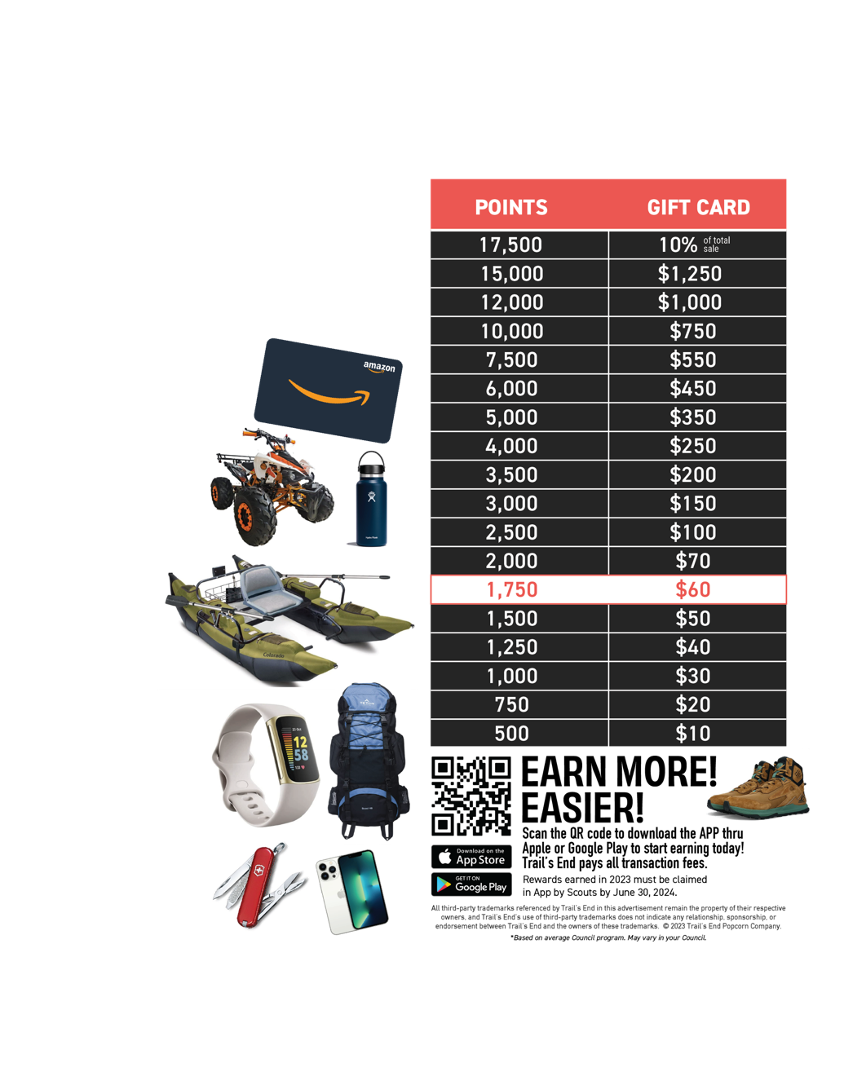
REWARDS
Scouts earn points towards an Amazon.com e-Gift Card when they record their sales in the Trail’s End App. They choose the prize they want!
Did You Know?!?
1,750 points ($1,500 in sales) provide funds for most Scouts’ Year of Scouting, including registration fees, handbook, uniform, Pack dues, camp, Scout Life magazine, and much more.
Plus, Scouts earn a $60 Amazon e-Gift card!*

Slide 10
TRAIL’S END 2023
TRADITIONAL PRODUCTS
Sweet and Salty
Kettle Corn
S’mores Popcorn
Popping Corn
White Cheddar Popcorn
$
$
$
$
Unbelievable
Butter Microwave Popcorn
Salted
Caramel Corn
Chocolatey
Pretzels
Sea Salt
Popcorn
$
$
$
$

Slide 11
2023 ONLINE ASSORTMENT
https://www.trails-end.com
$20
$25
$25
NEW
$27
$34
$50
NEW
NEW
NEW
$42
$47
$72
$62
$54
$45
NEW
NEW
Road Trip Variety Pack
Movie Night Bundle
Picnic Bundle
Let’s Go Hiking Bundle
Ultimate Snack Pack
Game Night Bundle
$27
$35
$30
$55
LIMITED TIME OFFERINGS:
Snowflake Pretzels 7 oz $35
Peppermint Bark 9 oz $40
Dark Choc Sea Salt Caramels 10.5 oz $35
Chocolate Lovers Bundle $95
Chocolate Trio Bundle $110
*Products & Pricing are subject to change

Slide 12
KEY DATES
Add these dates to your Calendar
[Date] Storefronts signups begin
[Date] Storefront sales begin
[Date] Wagon sales begin
[Date] Last day to return Wagon inventory
[Date] Last storefront sale
[Date] Final orders due
[Date] Cash collected due to Popcorn Kernel
[Date] Final order distributed (including Chocolate)
[Date] Popcorn Celebration!

Slide 13
HAVE QUESTIONS?
GET ANSWERS
Unit Leaders
Name
Email Address
Phone number
Name
Email Address
Phone number
Trail’s End Support
Join Scout Parent Facebook Group
Text PARENTFB to 62771
Visit our FAQ’s
https://support.trails-end.com

